Slide 1
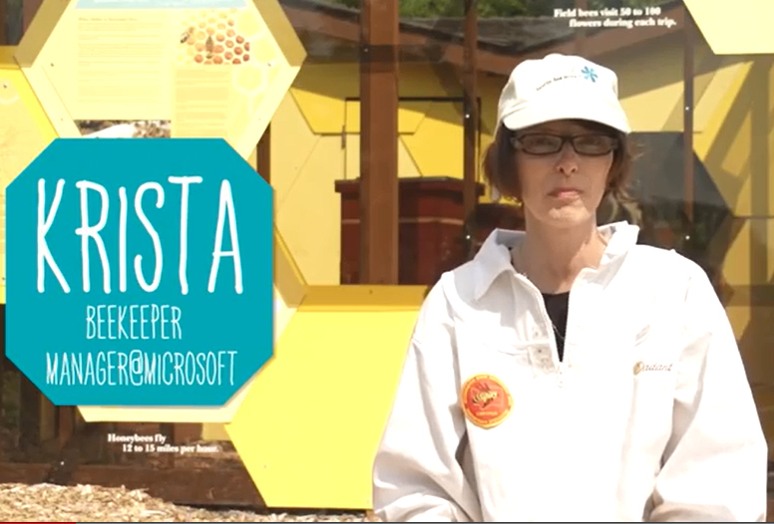
Stage 14: Bee: Debugging
What is debugging?
What are some strategies for debugging?

Slide 2
Objectives
Students will:
Predict where a program will fail
Modify an existing program to solve errors
Identify an algorithm that is unsuccessful when the steps are out of order
Reflect on the debugging process in an age-appropriate way

Slide 3
Video
https://studio.code.org/s/course3/stage/14/puzzle/1

Slide 4
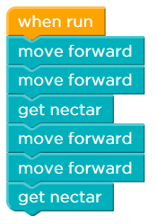
Example #1
Fix the code for the bee to succeed.
How many blocks need to be changed?
Notes:
moveForward(); moveForward(); getNectar(); moveForward(); moveForward(); getNectar();

Slide 5
Example
( more challenging)

Slide 6
Directions
Complete Stage 14: Bee: Debugging
Progress your way through the stage

